Slide 1

Eye Strain
Computer Health project for ICS3U

Slide 2
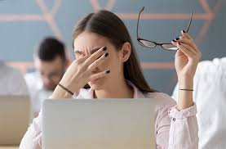
What is Eye Strain?
Eye Strain is sort of like a small pain in the eyes from starring at a screen for too long without taking a break.

Slide 3

Why is Eye Strain such a big deal?
Eye Strain is a big deal because it also poses other problems as well. Eye Strain can also cause other pains such as Headaches, Blurry Vision, or even neck pains.

Slide 4
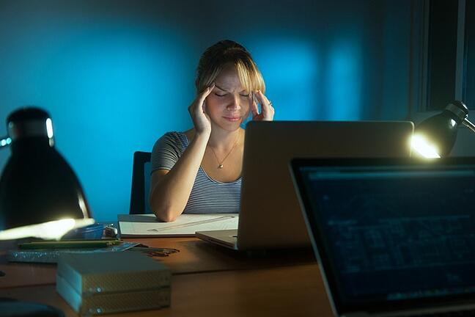
How is Eye Strain caused?
Eye Strain can be caused from:
Poor lighting
Staring / Glaring at a computer screen for so long.
Incorrect distance from the screen
Poor seating posture
A combination of any of these

Slide 5

Different names for Eye Strain.
Eye Strain is not the full proper name. The full name / term is called Computer Vision Syndrome.

Slide 6
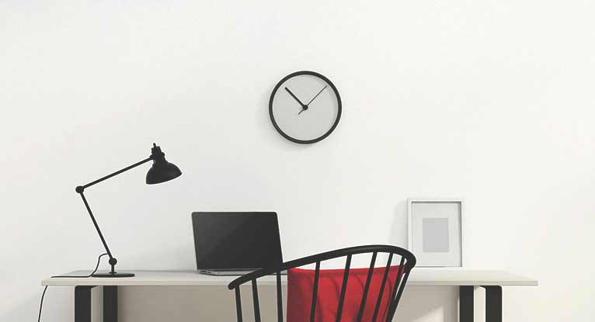
How can you get rid of it?
If your eyes are in pain from starring at the screen for too long, it is a good idea to take a break and let your eyes rest for about 15 minutes. Taking a break should also help relieve any other pains that you might also be affecting you.

Slide 7
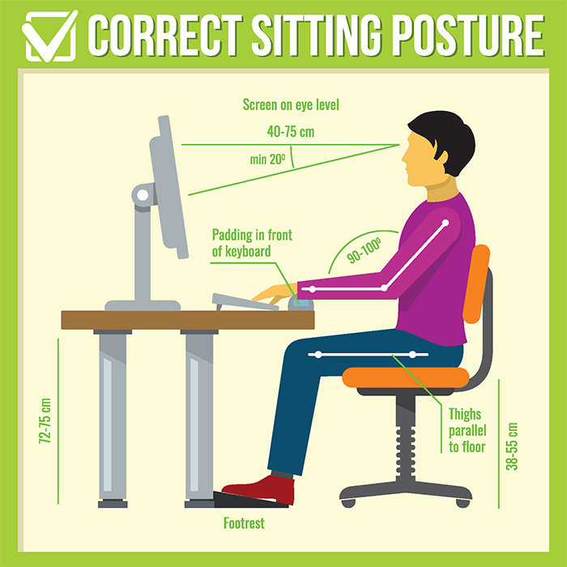
How can you prevent it?
One way you can help prevent Eye Strain is to sit in the correct position. Good Posture help prevent most pain when using computers.

Slide 8
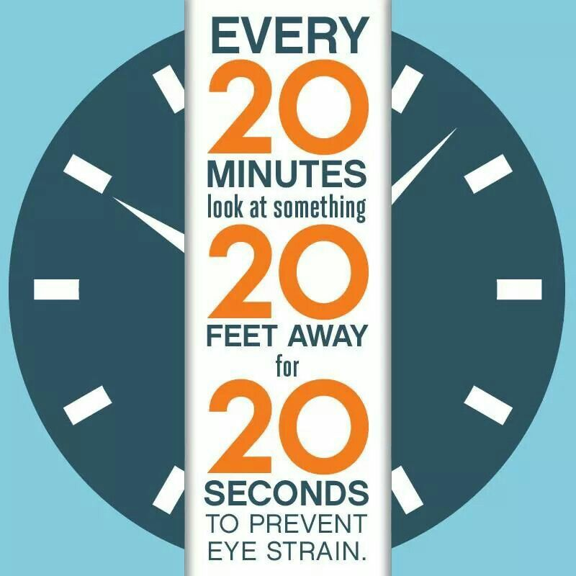
The 20/20/20 Rule
Another way you can help prevent eye strain, is by following a 20/20/20 rule. Every 20 minutes, find and look at something 20 feet away, for 20 seconds. This way you can focus on something off screen.

Slide 9
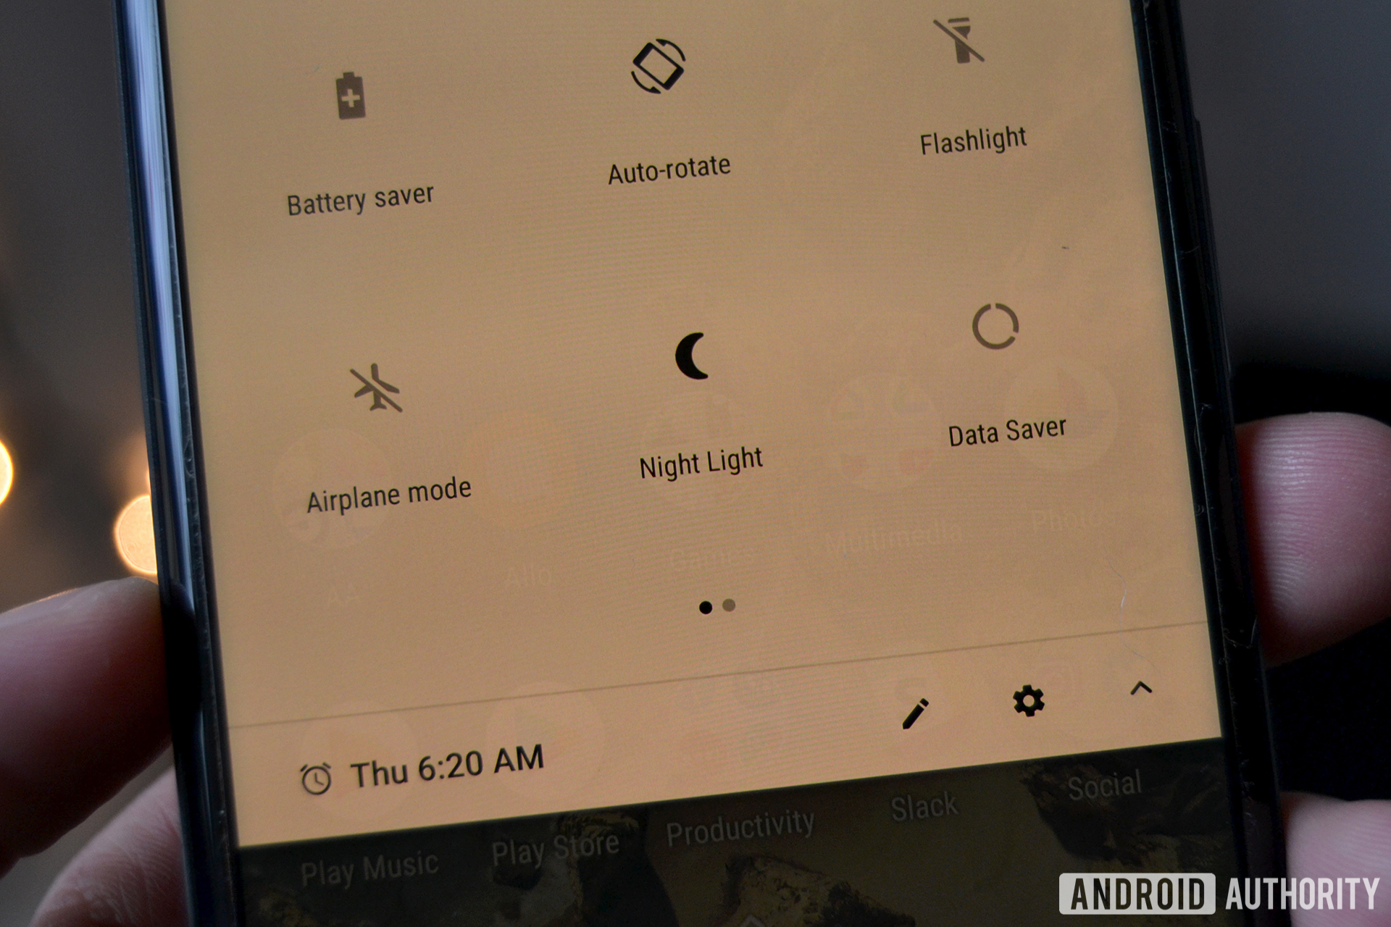
Night Light
Phones these days also have a feature equipped called Night Light. This mode is not a flash light for you to sleep, its to help reduce the strain on your eyes, especially at night.

Slide 10

In Conclusion
For your health, remember to take breaks and keep a good posture when using computers.

